Slide 1
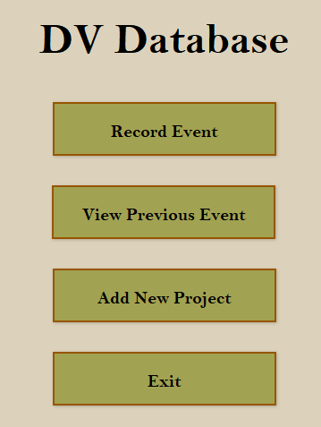
Home Page
DV Database App
Primary feature; directs user to data entry pages to record samples
View and edit previous entries; useful for quality checking (QC).
Allows you to add new projects. Likely won’t happen often.
Closes the application.

Slide 2
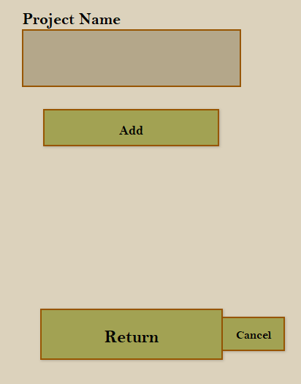
Add New Project
Simple process; input site/project data, click add, and return.

Slide 3
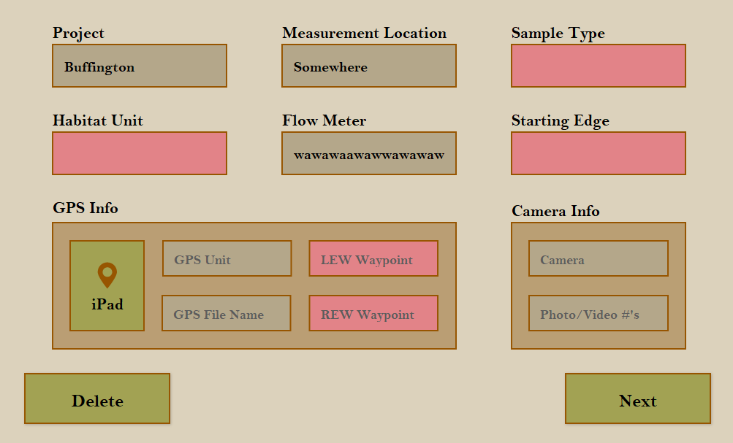
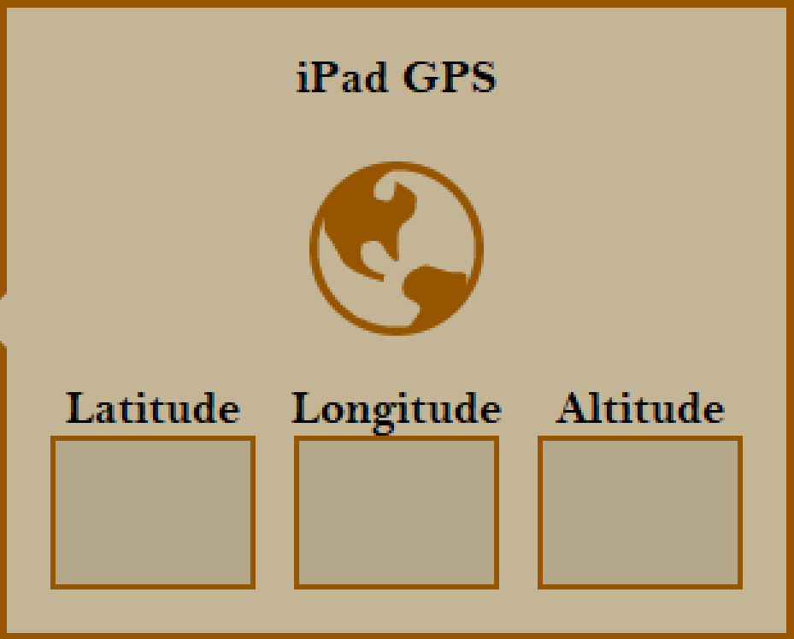
Record Event
Some fields are highlighted red when empty; QC
3 sample types (dropdown):
Cross-section
Vertical Profile
Spot Measurement
Project field dropdown
Clicking on green iPad button opens GPS tab
Click globe button to autofill lat/lon/alt data
Deletes the current event entirely
Navigates to field info page

Slide 4
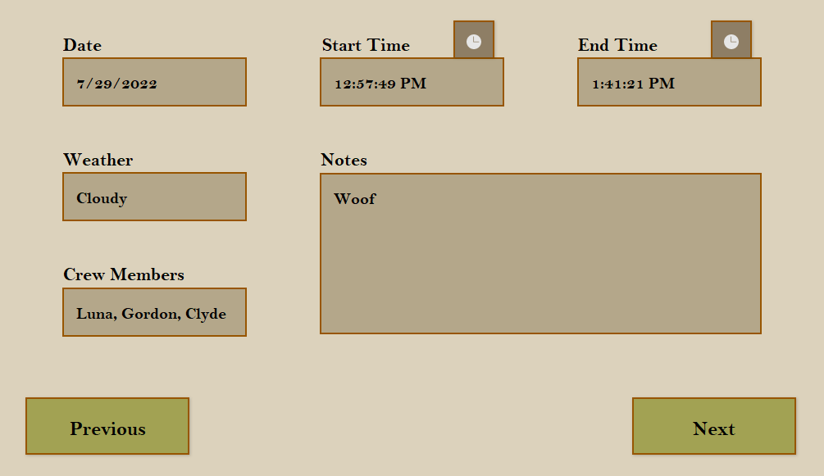
Field Info
Date and Start Time fields autofill, but can be edited
Clock icons autofill the current time
Weather field dropdown:
Clear
Cloudy
Fog
Rainy
Windy
Navigate to previous page
Navigate to sample-specific data page

Slide 5
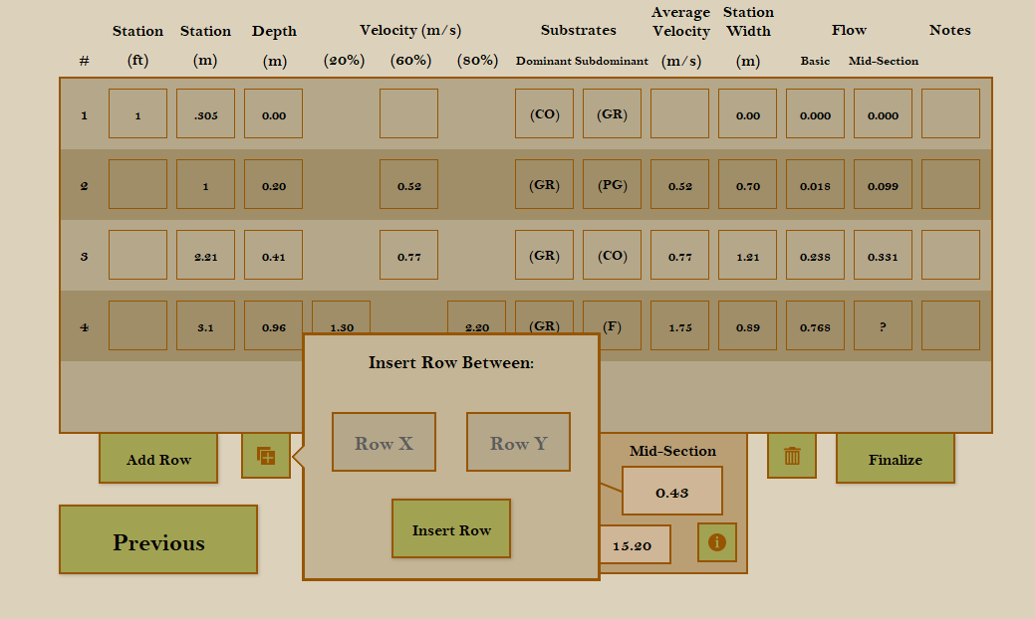
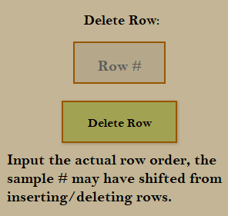
Cross-section Data
When depth >= 0.6, two velocity measurements are required
(first sample type)
These fields auto-calculate based on data in other fields
Feet field auto-calculates based on meter field entries
#of samples varies, so rows are added/inserted as needed
…and removed as needed
Prevents addition/deletion of rows and finalizes calculations

Slide 6
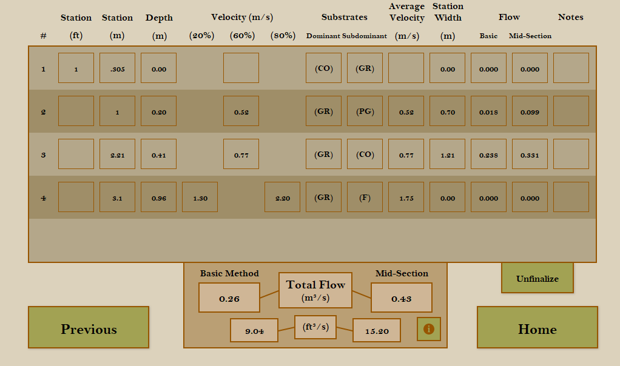
Cross-section Data
After pressing finalize:
Can’t add/delete rows
All calculation fields display correct values
Home button appears

Slide 7
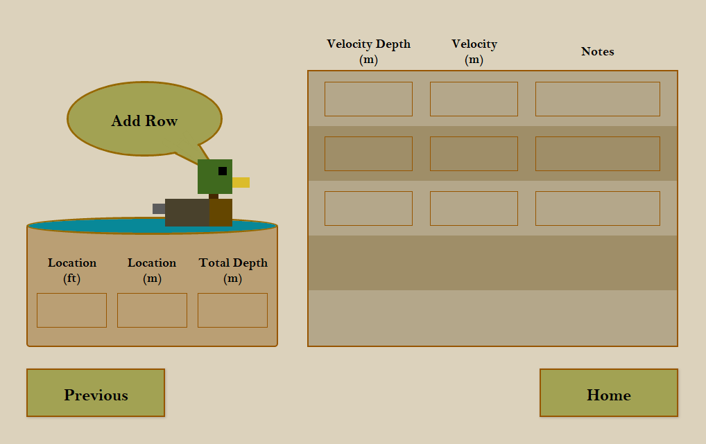
Vertical Profile Data
(second sample type)
One row = 1 sample
Click to add row
All samples correspond to same location for this sample type

Slide 8
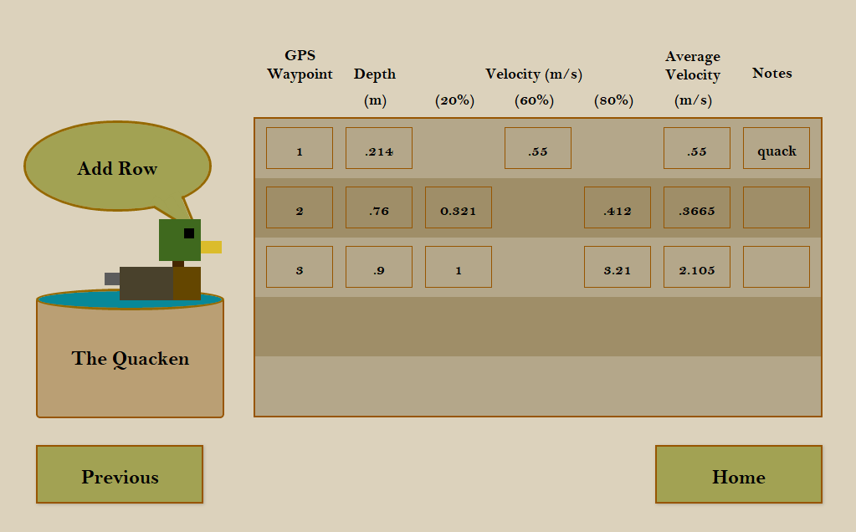
Spot Measurement Data
(third sample type)
Nothing new

Slide 9
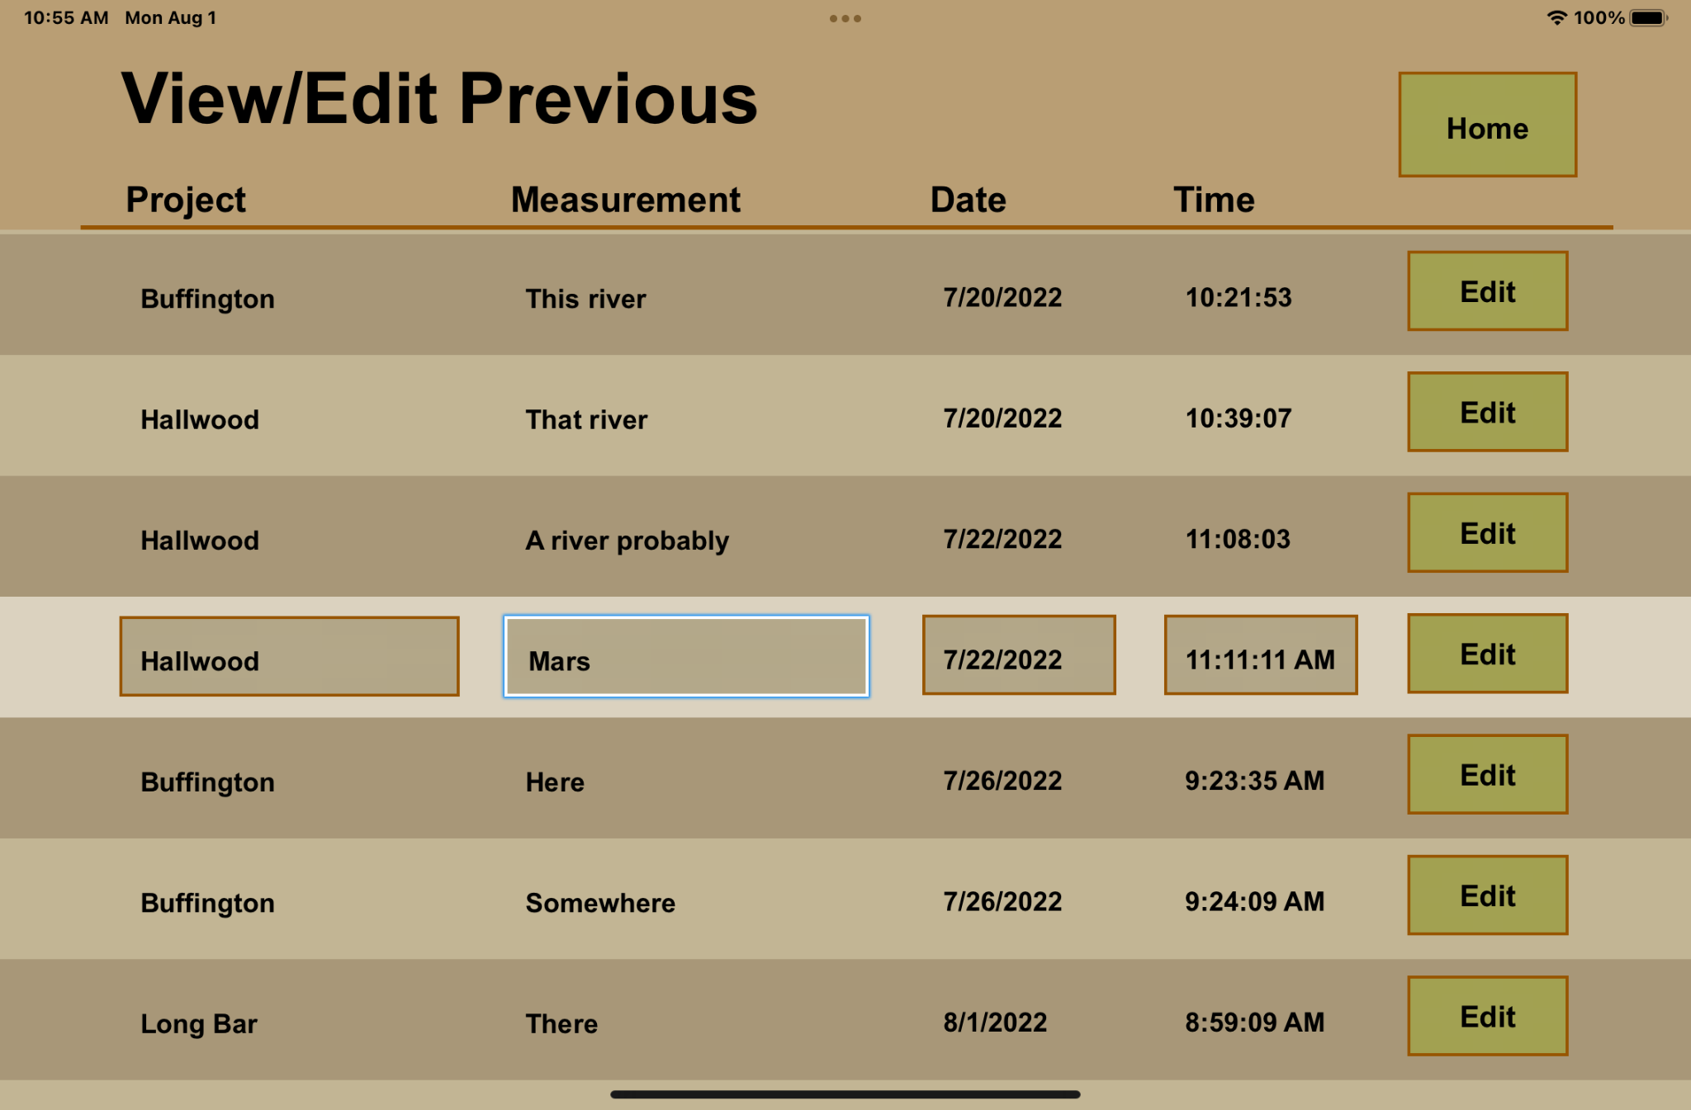
View and Edit Previous Records
(second option on home page)
Clicking edit will direct the user to the selected event and allow them to review, edit, or delete data from the event.

Slide 10
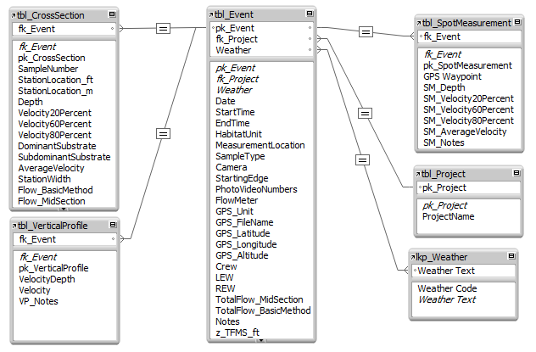
Backend Relational Database
Sample-specific tables:
Hold all sample data
All samples from a given event have that event’s ID
Primary table; holds all general event data
Stores
Project
names
Weather lookup table; stores weather code

